Slide 1

AUTO-FILLER
FORM AUTO-COMPLETION USING OCR
Mentor: Wajid Bin Aqeel

Slide 2
Group Members
S M Bilal Arshad
Muhammad Mustafa Bawany
Muhammad Yaseen Amir
Ibad Saleem

Slide 3
Introduction
This project is dedicated to creating an OCR software that recognizes text and patterns on resumes and CVs to auto-complete application forms.
It is found that many job applicants bounce off job portals with manual forms, so to address this problem we will parse out their resumes.

Slide 4
Problem Statement
Many job portals still don’t have any AI auto-form completion; even if they do, they fail on resumes made with templates. This causes job applicants to fill out and correct the forms, creating a time-consuming activity.
Problems We face:
Wrong Information input.
Time Consuming (Multiple pages on forms).
A company might lose a good employee
An individual might lose a good job

Slide 5
Proposed Solution
Create an OCR-based AI model, trained on multiple templates from the internet which can parse resumes
Fill out the information like Email, Phone Number, Github, LinkedIn, Education, and Experience.

Slide 6
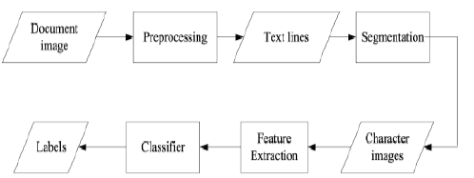
Process Flow

Slide 7
Future Roadmap
Create a chrome extension or a web-based application
Add certifications, honors, and awards sections
Making code more scalable
Adding an additional feature of evaluating resumes based on grammar and design, and providing recommendations to improve.

Slide 8
Type of Dataset
A Filebase Dataset, containing resumes in the form of pdf or word documents. Converting them into images and parsing text from those images through OCR.

Slide 9
Source of Dataset
The dataset has been extracted from Kaggle. Below is the link to the dataset.
https://www.kaggle.com/datasets/aishikai/resume-dataset

Slide 10
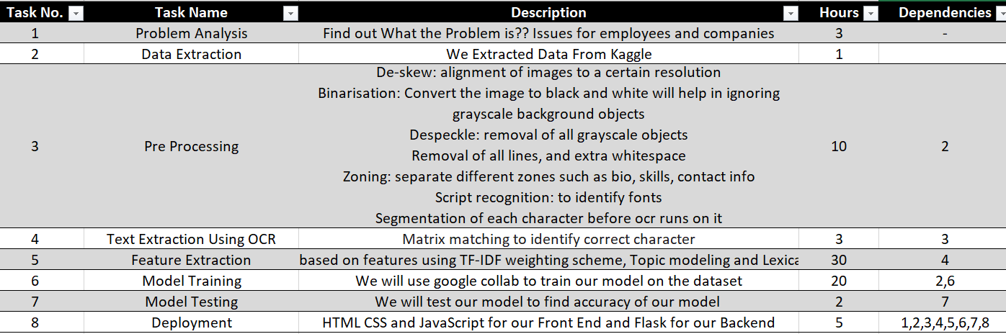
Work Breakdown Structure

